Slide 1
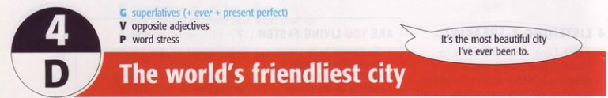
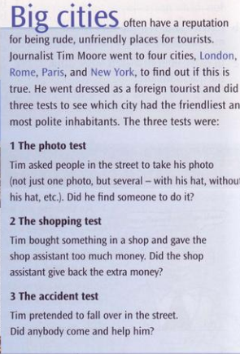
a Read the introduction to the article. In pairs, anwer the questions:
1 What are these tests?
2 Do you think they are good ones?
3 Which city o you think will be the friendliest/ most unfriendly?
New York was the friendliest and London was the most unfriendly.

Slide 2
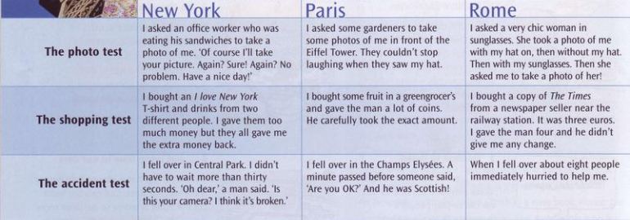
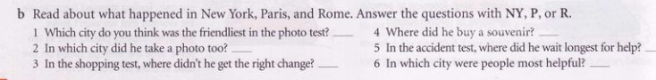
NY & R
NY
R
P
R
R

Slide 3
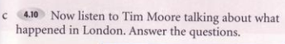

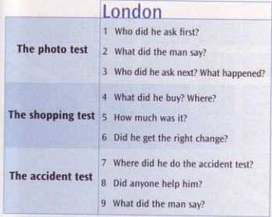
A man
No, no, no time for that
A businessman. To take a photo
He bought a key ring and a red bus in Oxford street
40 pounds
Yes
In the Tube ( the London Underground)
No
Why don’t you look where you are going

Slide 4
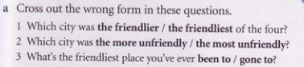
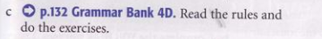

Slide 5
Superlative adjectives
Examples:
Red car is the fastest of all / in the group
Dinosaur is the tallest.
/’dainəsɔ:/

Slide 6
We use superlative adjectives to compare three or more people,things, etc.
USES:
Ex: He is the most intelligent student in the class.
We often use superlative adjectives with the present perfect.
Ex: Russia is the coldest place we’re ever been to.
It’s the most beautiful church I’ve ever seen.

Slide 7
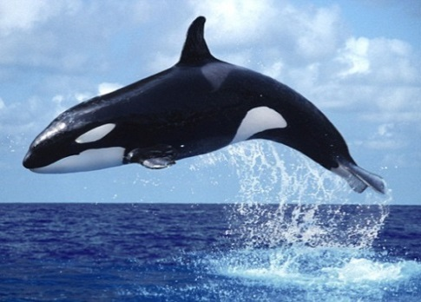
Short adjectives
cold
big
cheap
slow
heavy
coldest
biggest
cheapest
slowest
heaviest
“the” +
The whale is the biggest animal in the ocean
S + tobe + the + short adj + est

Slide 8
Long adjectives
interesting
intelligent
dangerous
expensive
beautiful
most interesting
most intelligent
most dangerous
most expensive
most beautiful
“the ” +
She is the most beautiful girl in the world.
S + tobe + the most + long adj

Slide 9
If a short adjective ends in one vowel + consonant we (a,e,i,o,u) (b,c,d,f,g,h,j,k,l,m...) double the consanant and add -est (except adjs ending “w”)
NOTES:
If a short adjective ends in e, we add -st
wide - widest large - largest
big - biggest
hot - hottest
thin - thinnest
fat - fattest
new - newest
slow - slowest
low - lowest

Slide 10
If an adjective (one or two sylabbles) ends with a consonant + y, we change y to -i and add -est.
shy - shiest
dry - driest
ugly - ugliest
happy - happiest
funny - funniest
easy - easiest
If a short adjective ends with a vowel + y, we add -est.
grey - greyest
gay - gayest

Slide 11
Irregular words change;
good = the best
bad = the worst /wɜ:st/
many/much = the most
little = the least
far = the farthest/furthest(tg+kc)
old = the oldest/eldest (cấp bậc)

Slide 12
IMPORTANT NOTE:
With some 2-syllable adjectives end in “le, er, ow, et”, we can use "-est" OR “most":
quiet → the quietest/most quiet clever → the cleverest/most clever narrow → the narrowest/most narrow simple → the simplest/most simple
gentle → the gentlest/ most gentle

Slide 13
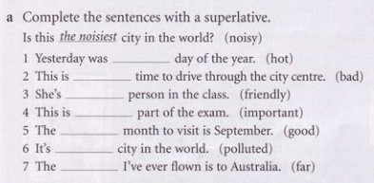
Exercises 4D
the hottest
the worst
the friendlest
the most importand
the best
the most polluted
the furthest

Slide 14
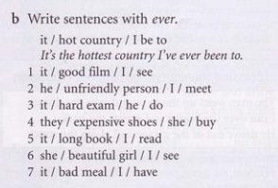
It’s the best film I’ve ever seen.
He’s the most unfriendly person I’ve ever meet.
It’s the hardest exam he’ve ever done.
They’re the most expensive shoes she’s ever bought.
It’s the longest book I’ve ever read.
She’s the most most beautiful girl I’ve ever seen.
It’s the worst meal I’ve ever had.

Slide 15
a What are the opposites of these adjectives?
friendly
rude
noisy
boring
unfriendly
polite
quiet
interesting

Slide 16
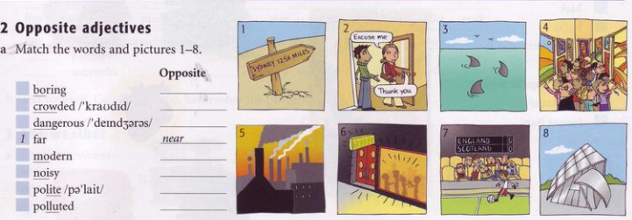
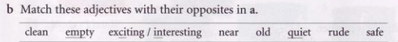
7
exciting/ interesting
4
empty
3
safe
8
old
6
quiet
2
rude
5
clean

Slide 17
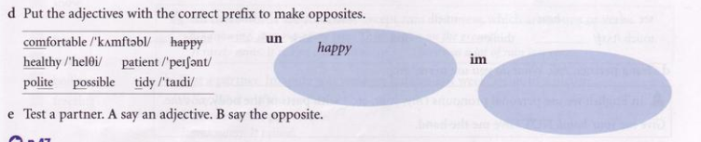
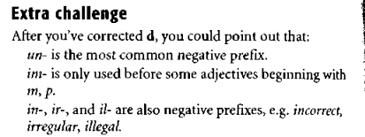
uncomfortable
unhealthy
untidy
impolite
impossible
impatient

Slide 18
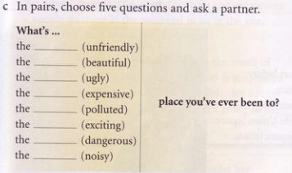
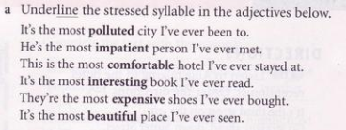
/pəˈluːtid/
/ɪm’peiʃənt/
/ˈkʌmfətəbl/
/ˈɪntristɪŋ/
/ɪkˈspensɪv/
/ˈbjuːtɪful/

Slide 19
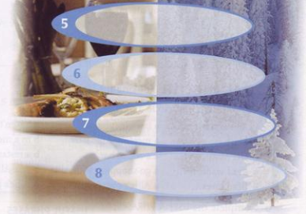
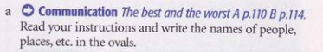
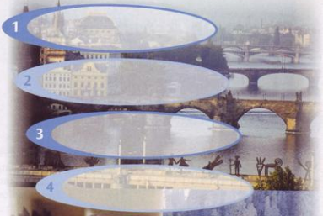
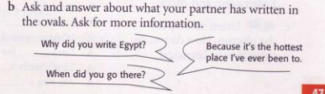

Slide 20
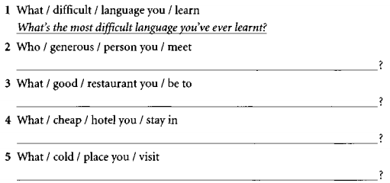
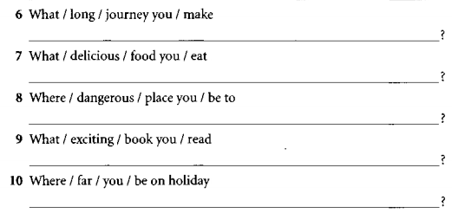
Exercises

Slide 21
